Slide 1
Multi drop UART

Slide 2
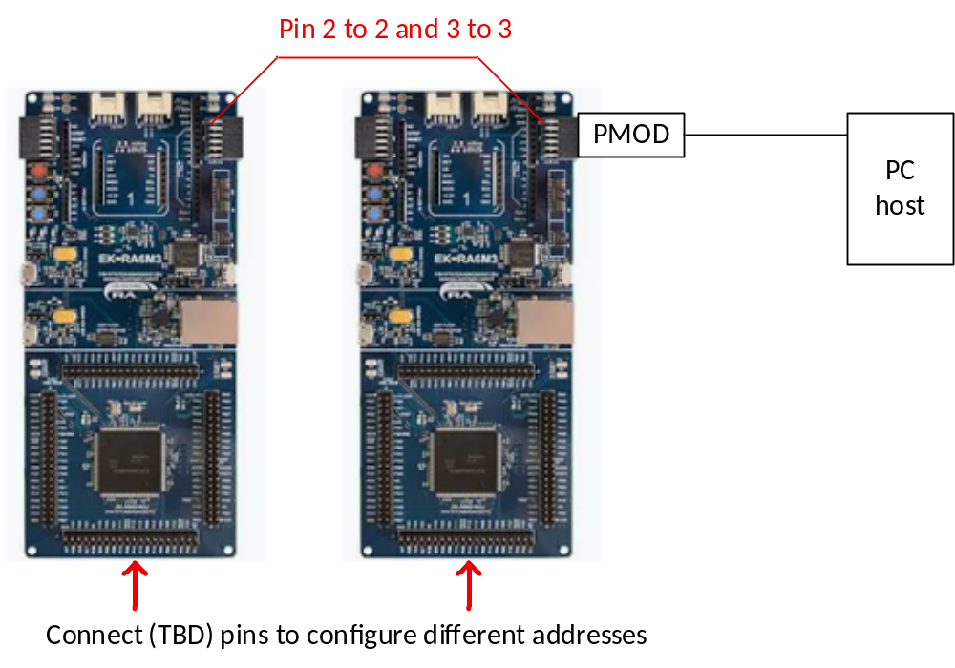
Steps
Configure different address by GPIO (TBD)
Connect TX and RX in parallel on two boards

Slide 3
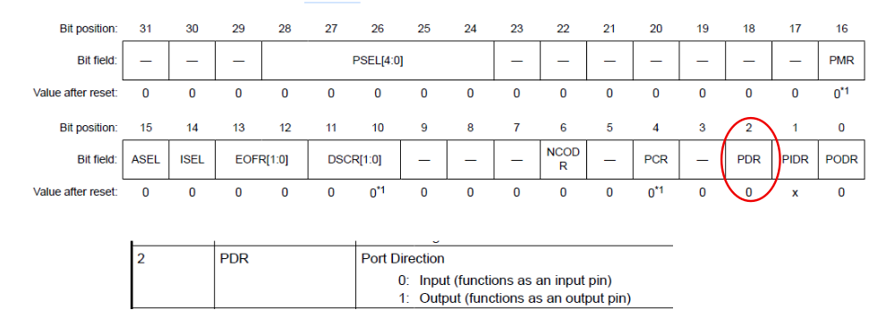
Steps
When the Sequencer board is NOT sending data, use the TX pin’s PFS register to configure the pin as an INPUT.
When the board has data to send, change the mode to output and send the data.
The Sequencer board TX line is biased high by pullup (prevent bogas start conditions)
Sequencer only sends data if address field matches.

Slide 4
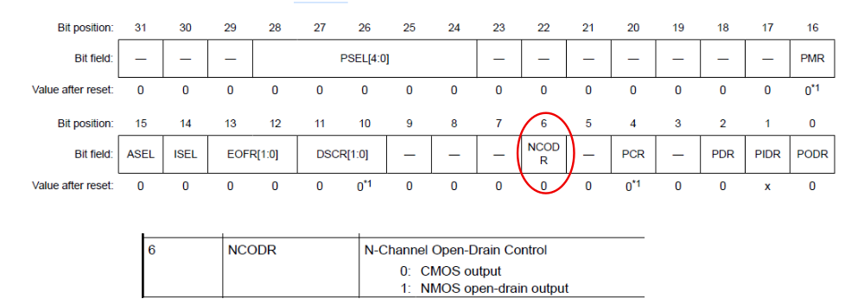
Steps
An alternate method would be to configure the pin open-drain

